Slide 1


CSE494 Project:
Sudoku Puzzle
By:
Tom Lang

Slide 2
Outline
What is Sudoku?
Variations of Sudoku Puzzle.
Puzzle I plan to solve.
How I plan on solving the puzzle using ASP.
Work Completed.
Work to be done.
Questions???

Slide 3
What is Sudoku??
Sudoku means single number
Logic-based number-placement puzzle. The objective is to fill a 9×9 grid so that each column, each row, and each of the nine 3×3 boxes contains the digits from 1 to 9 only one time each. (Wikipedia)
This type of puzzle comes partially filled in depending on difficulty level.
Modern puzzle was created by American Architect Howard Garns in 1979. (Wikipedia)

Slide 4
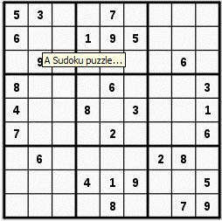
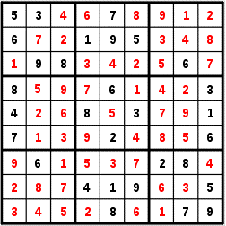
Types of Sudoku
Standard Sudoku (ASU paper)
    What you are given This is the solution

Slide 5
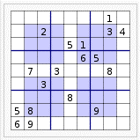
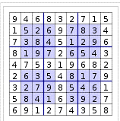
Types of Sudoku Cont.
Hypersudoku Solution

Slide 6
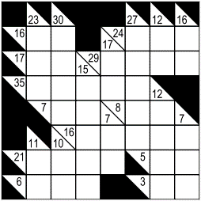
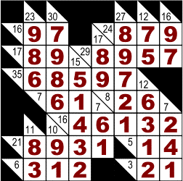
Types of Sudoku Cont.
Kakuro Solution

Slide 7
Puzzle I will Solve
3 variations of Sudoku puzzles combined
  Modern Sudoku
  Kakuro
  Hypersudoku

Slide 8
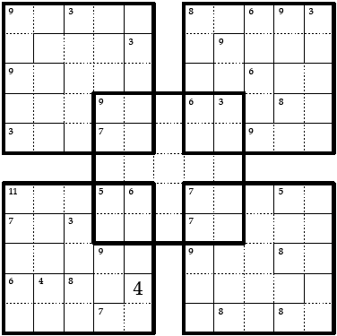
Puzzle I will Solve

Slide 9
How I plan on solving it using ASP
Generate all possible solutions
Eliminate repeats
  Repeat number in same column or row
Eliminate solutions that do not have the same numbers in the overlapping parts.
Eliminate solutions that don’t have the correct sum in the sub-groups.

Slide 10
Completed
Completed puzzle by hand
Created all possible solutions.
Eliminated the solutions with rows and columns with the same number.
Eliminated all solutions that don’t have the same overlapping corners.

Slide 11
Work to done
Eliminate all possibilities that don’t add up to the correct sub-group value.
Test
Optimize code.

Slide 12

Questions

Slide 13
BACKUP

Slide 14
References
wikipedia, "Sudoku." wikipedia. 12 NOV 2008. 12 Nov 2008 <http://en.wikipedia.org/wiki/Sudoku>.

